Slide 1
Exception Handling

Slide 2
Exception Handling
The Exception Handling is one of the powerful mechanism to handle the runtime errors so that normal flow of the application can be maintained.
An exception is an event that disrupts the normal flow of the program. It is an object which is thrown at runtime.

Slide 3
Types of errors
There are three categories of errors:
syntax errors,
runtime errors, and
logic errors.
Syntax errors arise because the rules of the language have not been followed. They are detected by the compiler.
Runtime errors occur while the program is running if the environment detects an operation that is impossible to carry out.
Logic errors occur when a program doesn't perform the way it was intended to.

Slide 4
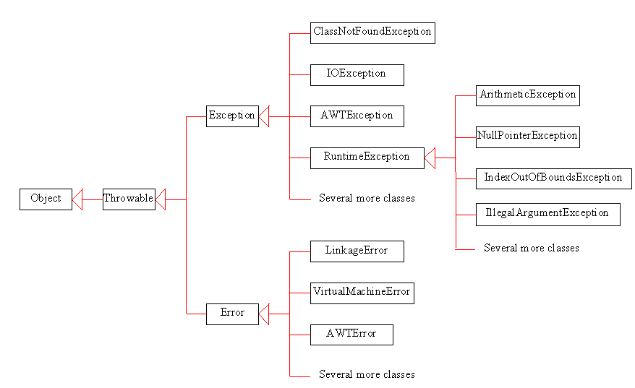
Exception class Hierarchy

Slide 5
Exception are categorized into 3 category.
Checked Exception
The exception that can be predicted by the programmer at the compile time.Example : File that need to be opened is not found. These type of exceptions must be checked at compile time.
Unchecked Exception
Unchecked exceptions are the class that extends RuntimeException. Unchecked exception are ignored at compile time. Example: ArithmeticException, NullPointerException, Array Index out of Bound exception. Unchecked exceptions are checked at runtime.
Error
Errors are typically ignored in code because you can rarely do anything about an error. Example : if stack overflow occurs, an error will arise. This type of error cannot be handled in the code.

Slide 6
Common scenarios where exceptions may occur
1) Scenario where ArithmeticException occurs
int a=50/0;
2) Scenario where NullPointerException occurs
String s=null;
System.out.println(s.length());
3) Scenario where NumberFormatException occurs
String s="abc";
int i=Integer.parseInt(s);
4) Scenario where ArrayIndexOutOfBoundsException occurs
int a[]=new int[5];
a[10]=50;

Slide 7
Java Exception Handling Keywords
There are 5 keywords used in java exception handling.
try
catch
finally
throw
throws

Slide 8
Java try block
Java try block is used to enclose the code that might throw an exception. It must be used within the method.
Java try block must be followed by either catch or finally block.
try{
//code that may throw exception
}catch(Exception_class_Name ref){}
Syntax of try-finally block
try{
//code that may throw exception
}finally{}

Slide 9
Java catch block
Java catch block is used to handle the Exception. It must be used after the try block only.
You can use multiple catch block with a single try.
try {
statements; // Statements that may throw exceptions
}
catch (Exception1 exVar1) {
handler for exception1;
}
catch (Exception2 exVar2) {
handler for exception2;
}
...
catch (ExceptionN exVar3) {
handler for exceptionN;
}

Slide 10
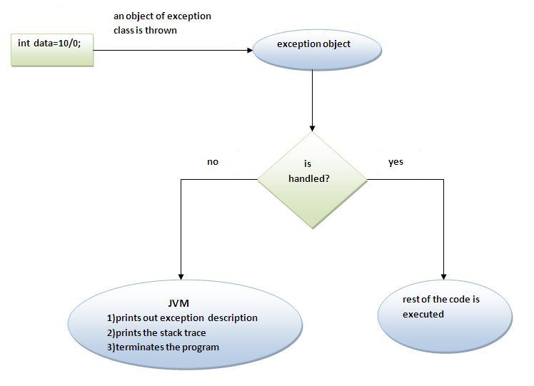
Internal working of java try-catch block

Slide 11
JVM
The JVM firstly checks whether the exception is handled or not. If exception is not handled, JVM provides a default exception handler that performs the following tasks:
Prints out exception description.
Prints the stack trace (Hierarchy of methods where the exception occurred).
Causes the program to terminate.
But if exception is handled by the application programmer, normal flow of the application is maintained i.e. rest of the code is executed.

Slide 12
Java catch multiple exceptions
public class TestMultipleCatchBlock
{
public static void main(String args[])
{
try{
int a[]=new int[5];
a[5]=30/0;
}
catch(ArithmeticException e)
{
System.out.println("task1 is completed");
}
catch(ArrayIndexOutOfBoundsException e){
System.out.println("task 2 completed");
}
catch(Exception e)
{
System.out.println("common task completed");
}
System.out.println("rest of the code...");
}
}
Output:
task1 completed
rest of the code...

Slide 13
Rule: At a time only one Exception is occurred and at a time only one catch block is executed.
Rule: All catch blocks must be ordered from most specific to most general i.e. catch for ArithmeticException must come before catch for Exception .v

Slide 14
public class MultipleCatchBlock1 {
public static void main(String[] args)
{
try{
int a[]=new int[5];
a[5]=30/0;
}
catch(ArithmeticException e)
{
System.out.println("Arithmetic Exception occurs");
}
catch(ArrayIndexOutOfBoundsException e)
{
System.out.println("ArrayIndexOutOfBounds Exception occurs");
}
catch(Exception e)
{
System.out.println("Parent Exception
occurs");
}
System.out.println("rest of the code");
}
}
Output:
Arithmetic Exception occurs
rest of the code

Slide 15
Java Nested try block
Sometimes a situation may arise where a part of a block may cause one error and the entire block itself may cause another error. In such cases, exception handlers have to be nested.
try
{
statement 1;
statement 2;
try
{
statement 1;
statement 2;
}
catch(Exception e)
{
}
}
catch(Exception e)
{
}

Slide 16
Java nested try example
try{
int a[]=new int[5];
a[5]=4;
}catch(ArrayIndexOutOfBoundsException e){System.out.println(e);}
System.out.println("other statement);
}catch(Exception e){System.out.println("handeled");}
System.out.println("normal flow..");
}
}
class Excep6
{
public static void main(String args[]){
try{
try{
System.out.println("going to divide");
int b =39/0;
}catch(ArithmeticException e){System.out.println(e);
}

Slide 17
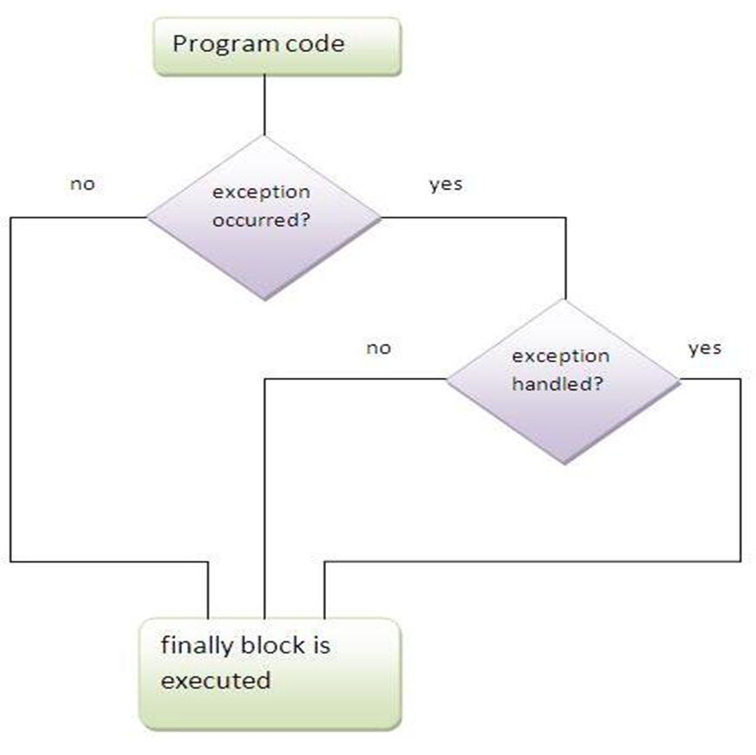
Java finally block
finally is a block that is used to execute important code such as closing connection, stream etc.
finally block is always executed whether exception is handled or not.
finally block follows try or catch block.

Slide 18
Why use java - finally
Finally block in java can be used to put "cleanup" code such as closing a file, closing connection etc.
Usage of Java finally
Let's see the different cases where java finally block can be used.

Slide 19
Case 1 Let's see the java finally example where exception doesn't occur.
catch(NullPointerException e){System.out.println(e);}
finally{System.out.println("finally block is always executed");}
System.out.println("rest of the code...");
}
}
class TestFinallyBlock{
public static void main(String args[]){
try{
int data=25/5;
System.out.println(data);
}
Output:5
finally block is always executed rest of the code...

Slide 20
Java throw keyword
The Java throw keyword is used to explicitly throw an exception.
We can throw either checked or uncheked exception in java by throw keyword. The throw keyword is mainly used to throw custom exception. We will see custom exceptions later.
The syntax of java throw keyword is given below.

Slide 21
public class TestThrow1{
static void validate(int age){
if(age<18)
throw new ArithmeticException("not valid");
else
System.out.println("welcome to vote");
}
public static void main(String args[]){
validate(13);
System.out.println("rest of the code...");
}
} Exception in thread main java.lang.ArithmeticException:not valid

Slide 22
Java throws keyword
The Java throws keyword is used to declare an exception. It gives an information to the programmer that there may occur an exception so it is better for the programmer to provide the exception handling code so that normal flow can be maintained.
Exception Handling is mainly used to handle the checked exceptions. If there occurs any unchecked exception such as NullPointerException, it is programmers fault that he is not performing check up before the code being used.

Slide 23
Syntax of java throws
return_type method_name() throws exception_class_name{
//method code
}
Which exception should be declared
Ans) checked exception only, because:
unchecked Exception: under your control so correct your code.
error: beyond your control e.g. you are unable to do anything if there occurs VirtualMachineError or StackOverflowError.

Slide 24
Advantage of Java throws keyword
Now Checked Exception can be propagated (forwarded in call stack).
It provides information to the caller of the method about the exception.
import java.io.IOException;
class Testthrows1{
void m()throws IOException{
throw new IOException("device error");//checked exception
}
void n()throws IOException{
m();
}

Slide 25
void p(){
try{
n();
}catch(Exception e){System.out.println("exception handled");}
}
public static void main(String args[]){
Testthrows1 obj=new Testthrows1();
obj.p();
System.out.println("normal flow...");
}
}
Output:
exception handled normal flow...

Slide 26
Difference between throw and throws in Java
NO. | THROW | THROWS
1) | Java throw keyword is used to explicitly throw an exception. | Java throws keyword is used to declare an exception.
2) | Checked exception cannot be propagated using throw only. | Checked exception can be propagated with throws.
3) | Throw is followed by an instance. | Throws is followed by class.
4) | Throw is used within the method. | Throws is used with the method signature.
5) | You cannot throw multiple exceptions. | You can declare multiple exceptions e.g. public void method()throws IOException,SQLException.

Slide 27
Difference between final, finally and finalize
No. | final | finally | finalize
1) | Final is used to apply restrictions on class, method and variable. Final class can't be inherited, final method can't be overridden and final variable value can't be changed. | Finally is used to place important code, it will be executed whether exception is handled or not. | Finalize is used to perform clean up processing just before object is garbage collected.
2) | Final is a keyword. | Finally is a block. | Finalize is a method.

Slide 28
Java final example
class FinalExample{
public static void main(String[] args){
final int x=100;
x=200;//Compile Time Error
}}

Slide 29
Java finally example
class FinallyExample{
public static void main(String[] args){
try{
int x=300;
}catch(Exception e){System.out.println(e);}
finally{System.out.println("finally block is executed");}
}}

Slide 30
Java finalize example
class FinalizeExample{
public void finalize(){System.out.println("finalize called");}
public static void main(String[] args){
FinalizeExample f1=new FinalizeExample();
FinalizeExample f2=new FinalizeExample();
f1=null;
f2=null;
System.gc();
}}

Slide 31
Interview questions
What is the meaning of immutable in terms of String?
Why string objects are immutable in java?
How many ways we can create the string object?
What is the difference between error and exception in java?
Can we keep other statements in between try, catch and finally blocks?
Can we throw an exception manually? If yes, how?
What is exception propagation ?

Slide 32
Thank You !

